Slide 1
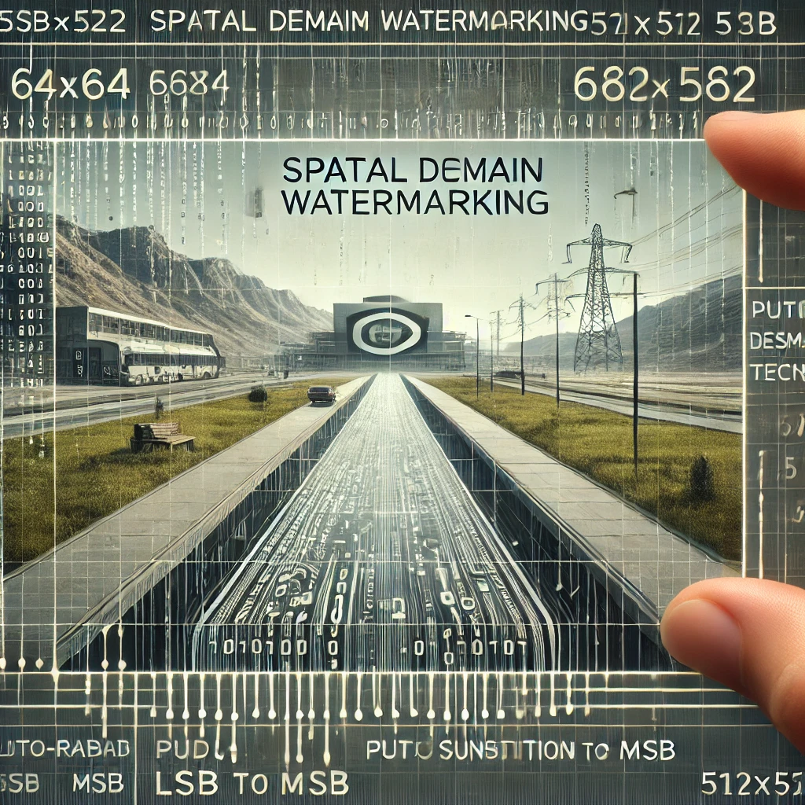
INFORMATION HIDING
Assignment 1
Generated by DALL-E
Adib Nikjou, Shiraz University of Technology, Spring 2025

Slide 2
What was the assignment? An overview
Watermark:
Logo: 64x64 binary SUTECH pattern
A pseudo random binary sequence (size: 64x64 bits)
Host Images: 512x512 (some sutech landscape and standard images)
Algorithms (spatial domain watermarking)
Select fixed location (locations) of the host image and use bit substitution (from LSB to MSB) for embedding for both watermarks
Repeat 1 but select host pixels pseudo randomly.

Slide 3



Watermark Patterns 64×64 Binary Embeddings
sutech logo
Resize(64, 64)
Binary
Shape: 236x203
RGB (24 Bit)
Shape: 64x64
RGB (24 Bit)
Shape: 64x64
Binary(1 Bit)

Slide 4
Watermark Patterns 64×64 Binary Embeddings
sutech logo
Shape: 64x64
(Zoomed)
24 Bit
Shape: 64x64
(Zoomed)
1 Bit

Slide 5

Watermark Patterns 64×64 Binary Embeddings
Pseudo Random
Shape = (64, 64)
random_image = np.array(
52.05 * np.random.randn(*shape) + 127.5,
dtype=np.uint8
)
return random_image > 127.5
Output
Shape: 64x64
Binary (1 Bit)

Slide 6
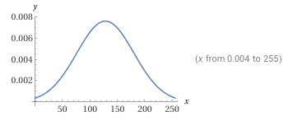
Watermark Patterns 64×64 Binary Embeddings
Pseudo Random
Thresholding
(T=127.5)
Shape: 64x64
Binary (1 Bit)
(Zoomed)

Slide 7
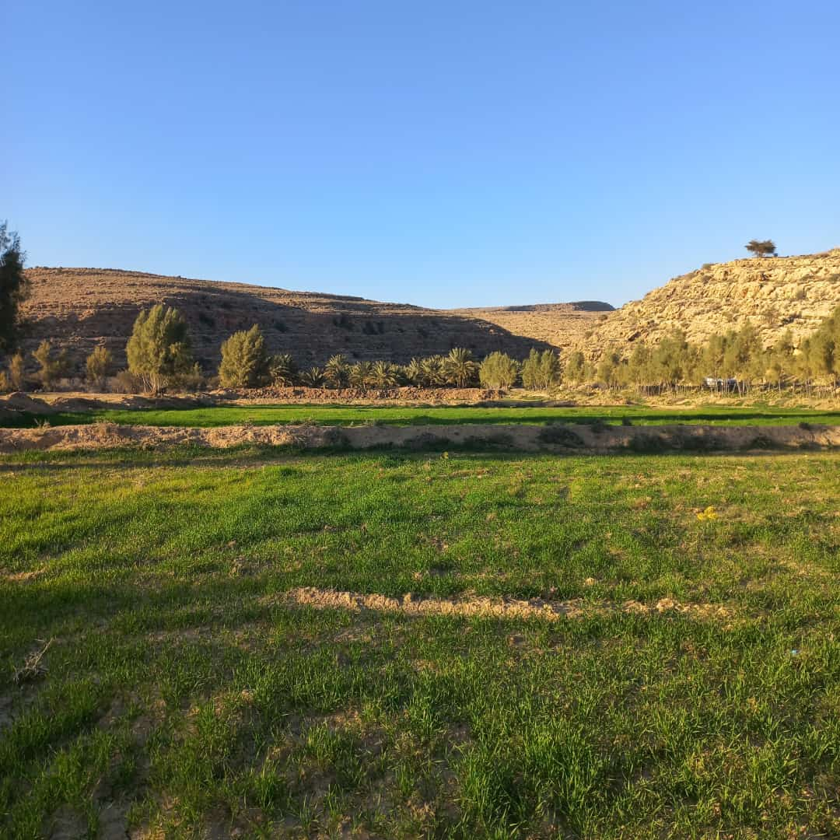

Host Image RGB-512x512 Image
Host image
Resize(512,512)
Shape: 512x512
Shape: 1080x1080

Slide 8
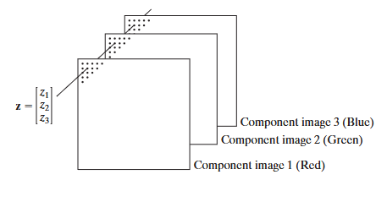
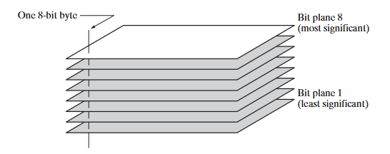
RGB Image Structure Explaining RGB composition
RGB
(24 Bit)
RED
(8 Bit)
GREEN
(8 Bit)
BLUE
(8 Bit)
Host image
Each RGB image consists of 3 separate grayscale channels (Red, Green, Blue)
Each grayscale channel is composed of 8 distinct bit planes (from LSB to MSB)

Slide 9
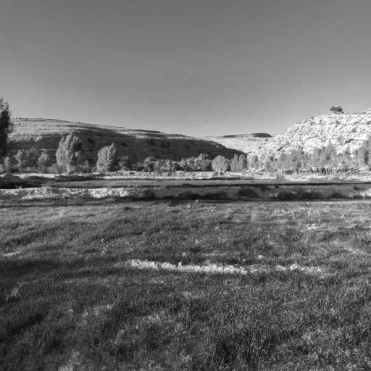
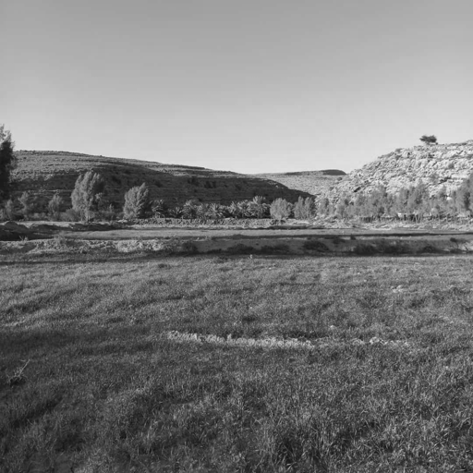
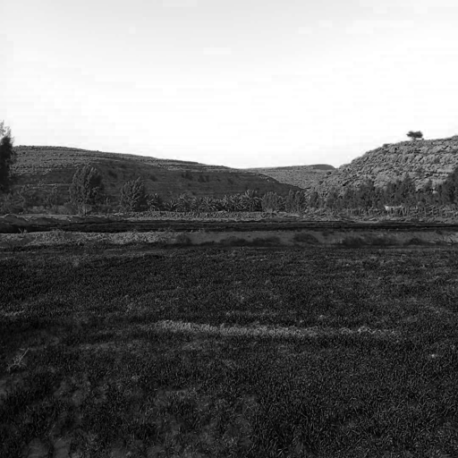
Host Image Analysis 512×512 grayscale images breakdown
Host image
Shape: 512x512
RGB (24 Bit)
Red Channel
Shape: 512x512
RGB (8 Bit)
Green Channel
Shape: 512x512
RGB (8 Bit)
Blue Channel
Shape: 512x512
RGB (8 Bit)

Slide 10
Host Image Analysis 512×512 Grayscale Bit Plane Decomposition
Host image
Red Channel
Shape: 512x512
RGB (8 Bit)

Slide 11

Host Image Analysis 512×512 Grayscale Bit Plane Decomposition
Host image
Green Channel
Shape: 512x512
RGB (8 Bit)

Slide 12
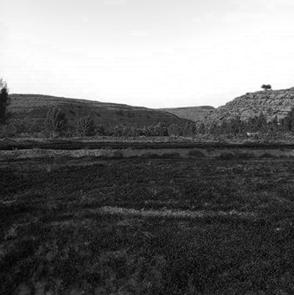
Host Image Analysis 512×512 Grayscale Bit Plane Decomposition
Host image
Blue Channel
Shape: 512x512
RGB (8 Bit)

Slide 13
Watermark Embedding Techniques OVERVIEW
Watermark Embedding Techniques
Spatial Domain
Transform Domain
Hybrid Methods
…
Bit substitution

Slide 14
Spatial Domain Algorithms bit substitution overview
Fixed Location Bit Substitution
Embeds watermark bits at predetermined positions in the host image
by replacing original pixel bits with watermark bits.
Locations remain constant across all watermarked images,
offering simplicity but potentially lower security.
Pseudo-Random Bit Substitution
Utilizes a seed-based random number generator to determine
embedding locations throughout the image. This creates a unique,
unpredictable pattern of modified pixels, enhancing security while maintaining similar visual quality to fixed location methods.
Bit substitution
Fixed Location Method
Pseudo Random Method

Slide 15
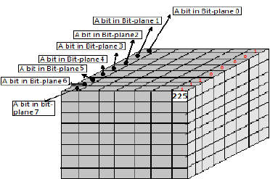
Bit substitution Algorithms where to put our watermark?
RGB
RED
BIT 7
BIT 6
GREEN
…
BLUE
BIT 5
BIT 4
BIT 3
BIT 2
BIT 1
BIT 0
…
Watermark Placement Strategy
Embedding occurs across one or more of the 24 available
bit planes (8 per channel)

Slide 16
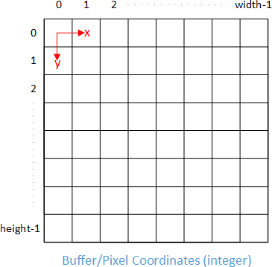
Bit substitution Algorithms python implementations
Fixed Location Bit Substitution
This code chooses the first 64x64 pixels of an image:
fixed_locations = [(i, j) for i in range(binary_watermark.shape[0]) for j in range(binary_watermark.shape[1])]

Slide 17
Bit substitution Algorithms python implementations
Pseudo-Random Bit Substitution
Chooses random pixels of an image.
We’ll Save the locations inside a .npy files to be able to load the coordinates.
random.seed(seed)
height, width = host_image_shape[0], host_image_shape[1]
# Generate unique random locations
all_pixels = [(i, j) for i in range(height) for j in range(width)]
# Randomly select pixels
random_locations = random.sample(all_pixels, watermark_size)
Sample Coordinates: [[ 39 244]
[292 486]
[147 198]
...
[ 89 206]
[435 132]
[181 62]]

Slide 18
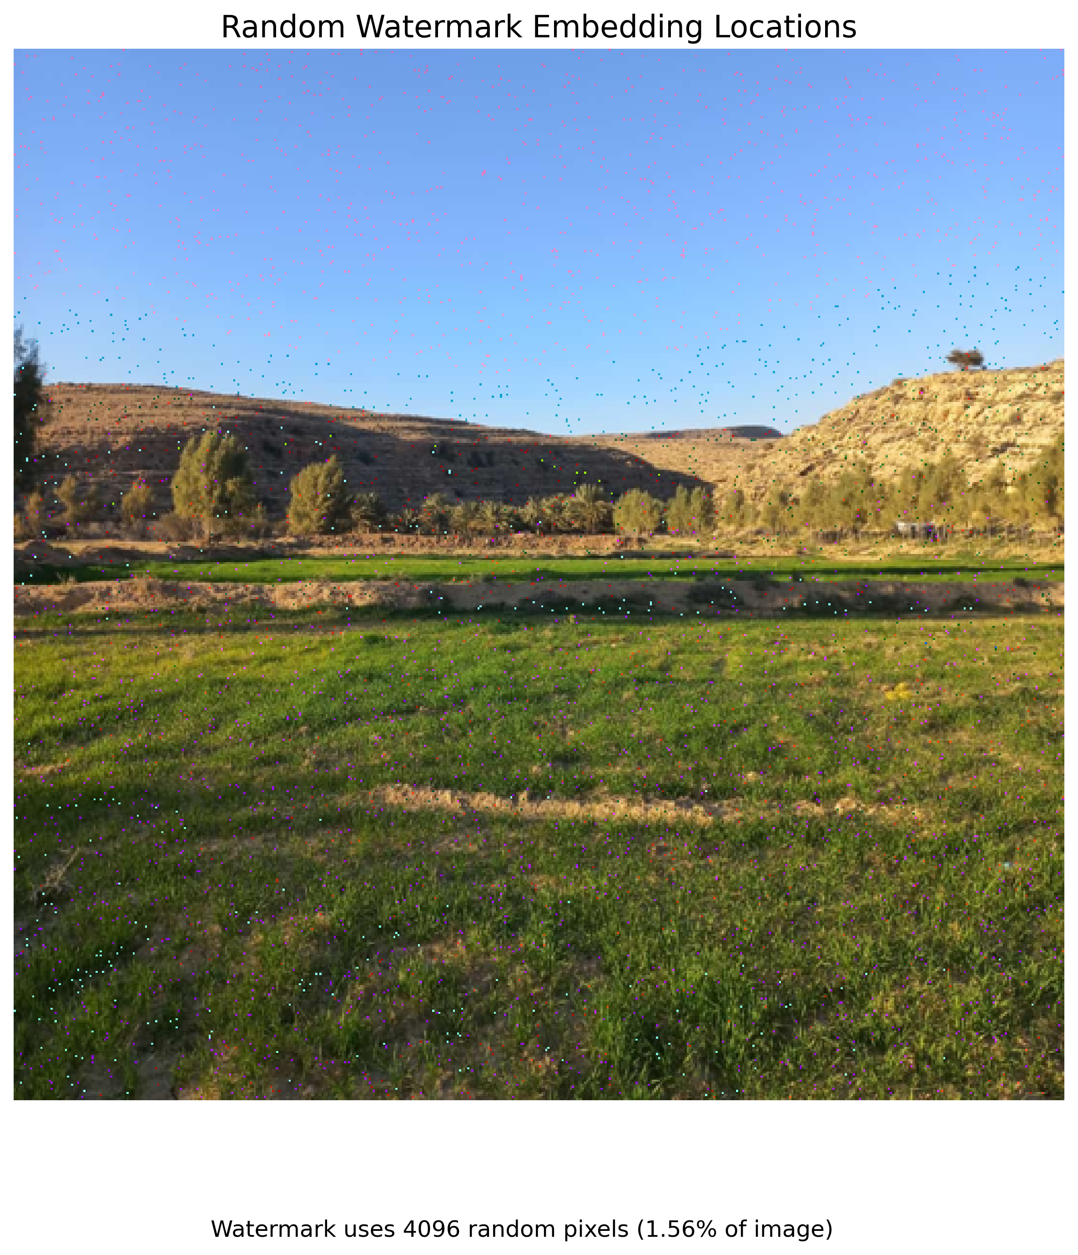
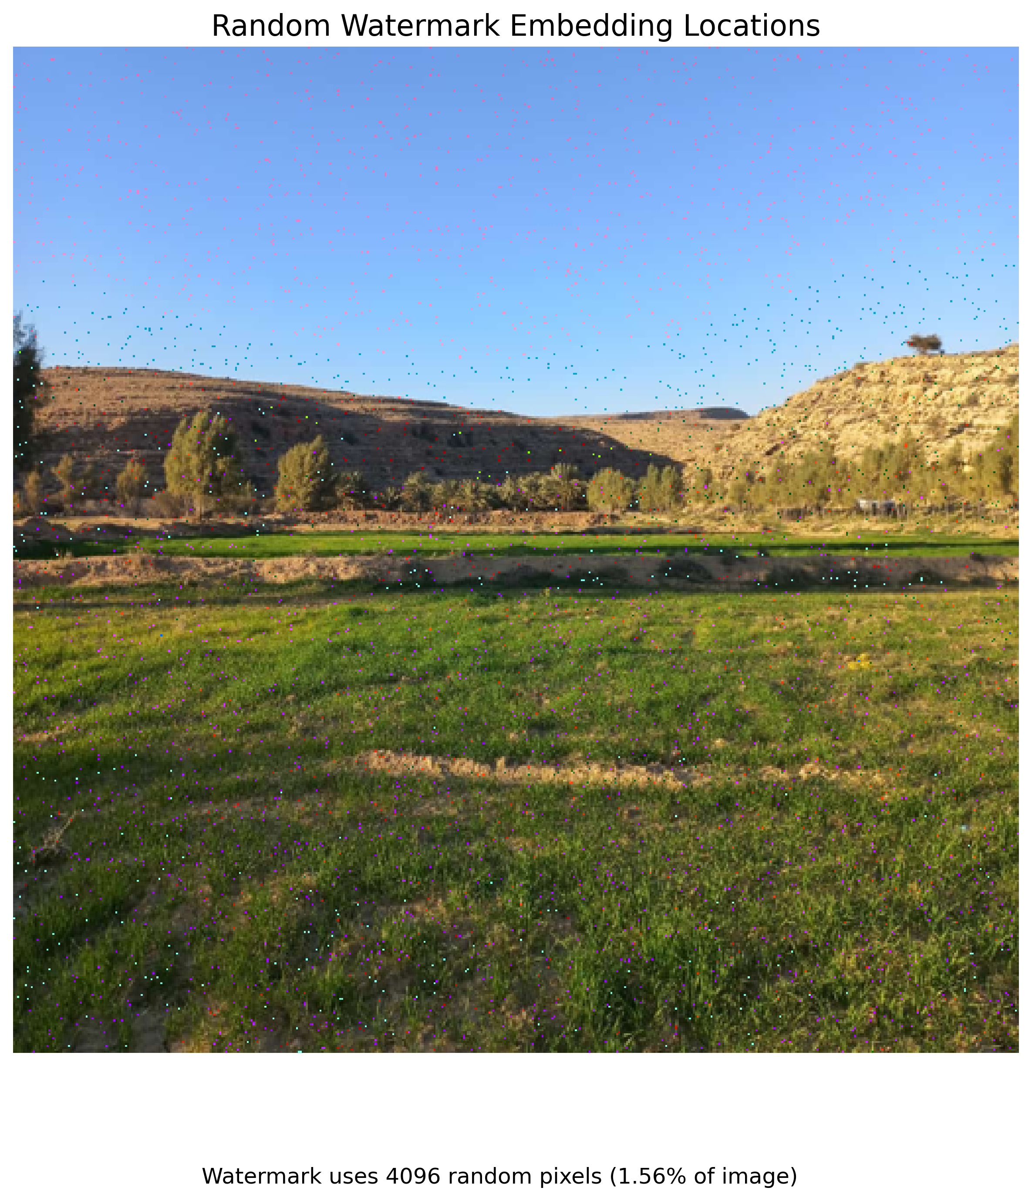

Slide 19
Bit substitution Algorithms python implementations – how to embed?
How to Embed the watermark?
We create the bit mask to clear the desired bit plane from the selected channel.
RGB
RED
BIT 7
BIT 6
GREEN
…
BLUE
BIT 5
BIT 4
BIT 3
BIT 2
BIT 1
BIT 0
…
host_copy = host_image.copy()
selected_channel = host_copy[:, :, channel]
# Create the bit mask to clear the target bit
clear_mask = ~(1 << bit_plane) & 0xFF
for idx, (i, j) in enumerate(pixel_locations):
pixel_cleared = selected_channel[i, j] & clear_mask # Clear bit
selected_channel[i, j] = pixel_cleared | (watermark.flat[idx] << bit_plane)
host_copy[:, :, channel] = selected_channel

Slide 20
Bit substitution Algorithms python implementations – how to Extract?
RGB
RED
BIT 7
BIT 6
GREEN
…
BLUE
BIT 5
BIT 4
BIT 3
BIT 2
BIT 1
BIT 0
…
How to Extract the watermark?
To extract the embedded watermark, we need to identify:
The location of the watermark in the media
The specific channel it's embedded in
The bit plane where it's stored
extracted_watermark = np.zeros(watermark_shape, dtype=np.bool)
selected_channel = watermarked_image[:, :, channel]
for idx, (i, j) in enumerate(pixel_locations):
extracted_watermark.flat[idx] = (selected_channel[i, j] >> bit_plane) & 1

Slide 21
Implementation Results Embedded Watermark Results for each channel
First, I'll present watermarked images in each channel using fixed locations (Sutech logo and Pseudo-random pattern). Then, we'll demonstrate results using Pseudo-random locations across each channel (displaying both the Sutech logo and Pseudo-random pattern).
BIT SUBSTITUTION
FIXED LOCATION
RED
BLUE
PSEUDO-RANDOM LOCATION
…
GREEN
SUTECH LOGO
FOR EACH BIT PLANE
PSEUDO RANDOM LOGO FOR EACH BIT PLANE

Slide 22
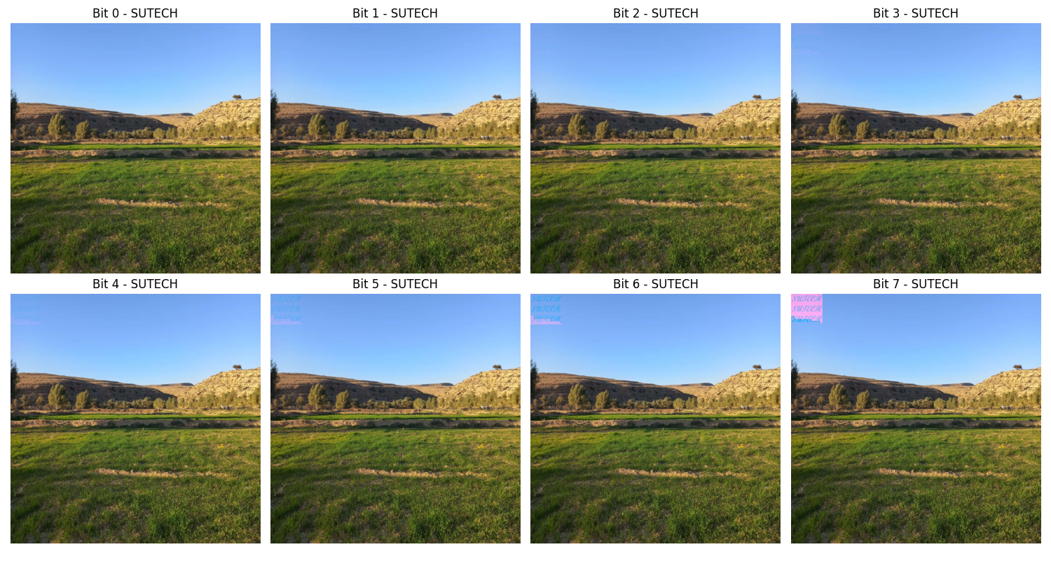
Fixed Location – Red Channel – Sutech Logo

Slide 23
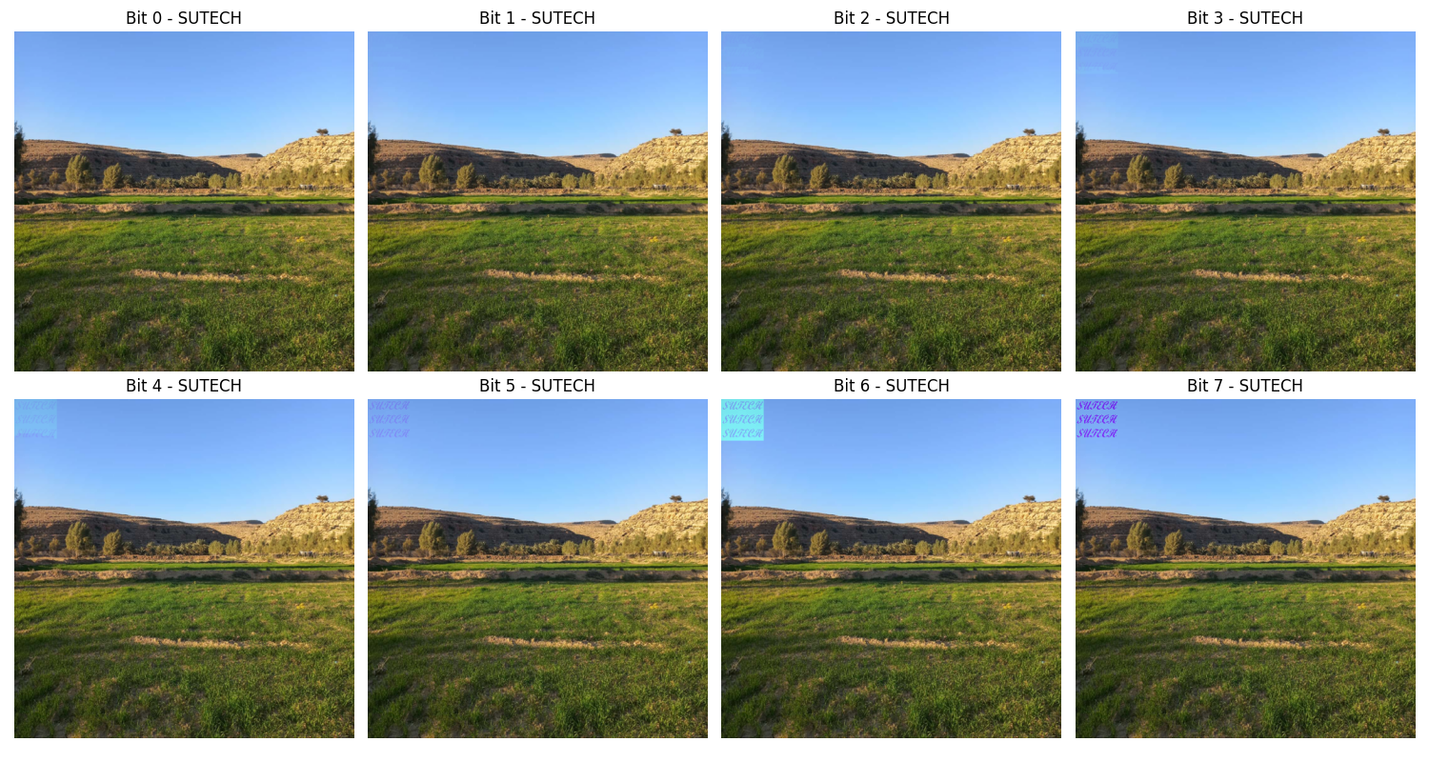
Fixed Location – Green Channel – Sutech Logo

Slide 24
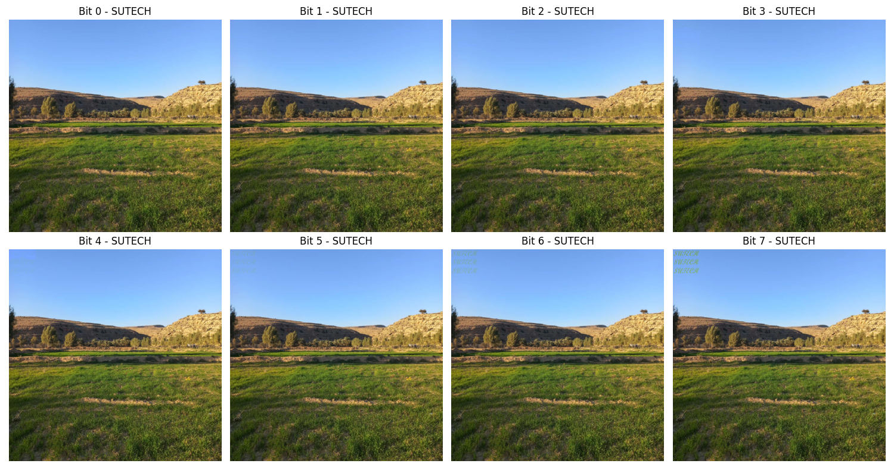
Fixed Location – Blue Channel – Sutech Logo

Slide 25
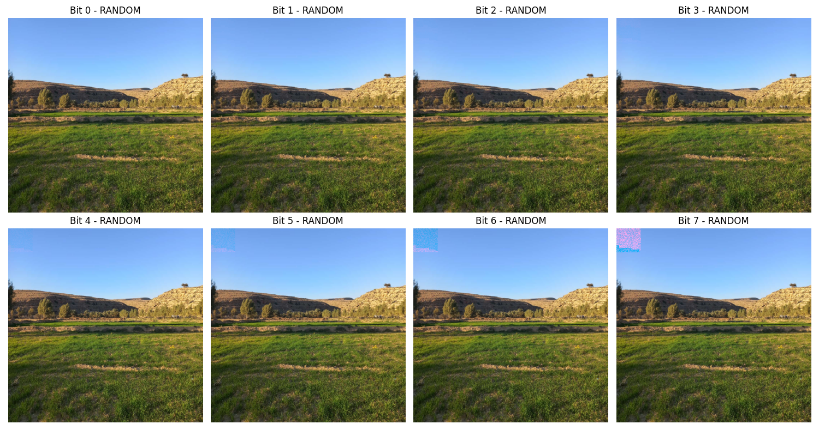
Fixed Location – Red Channel – Pseudo Random Logo

Slide 26
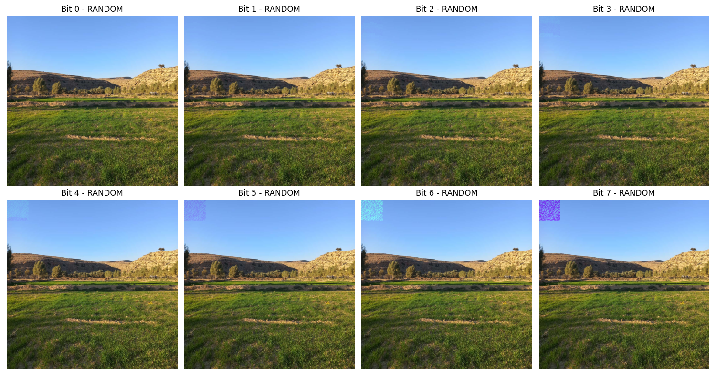
Fixed Location – Green Channel – Pseudo Random Logo

Slide 27
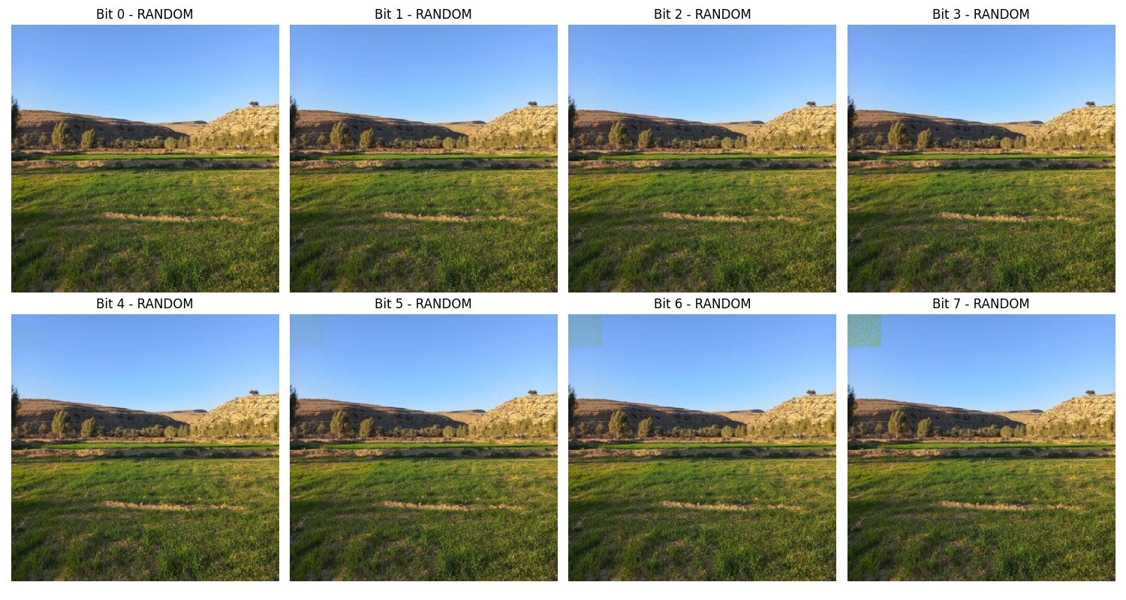
Fixed Location – Blue Channel – Pseudo Random Logo

Slide 28
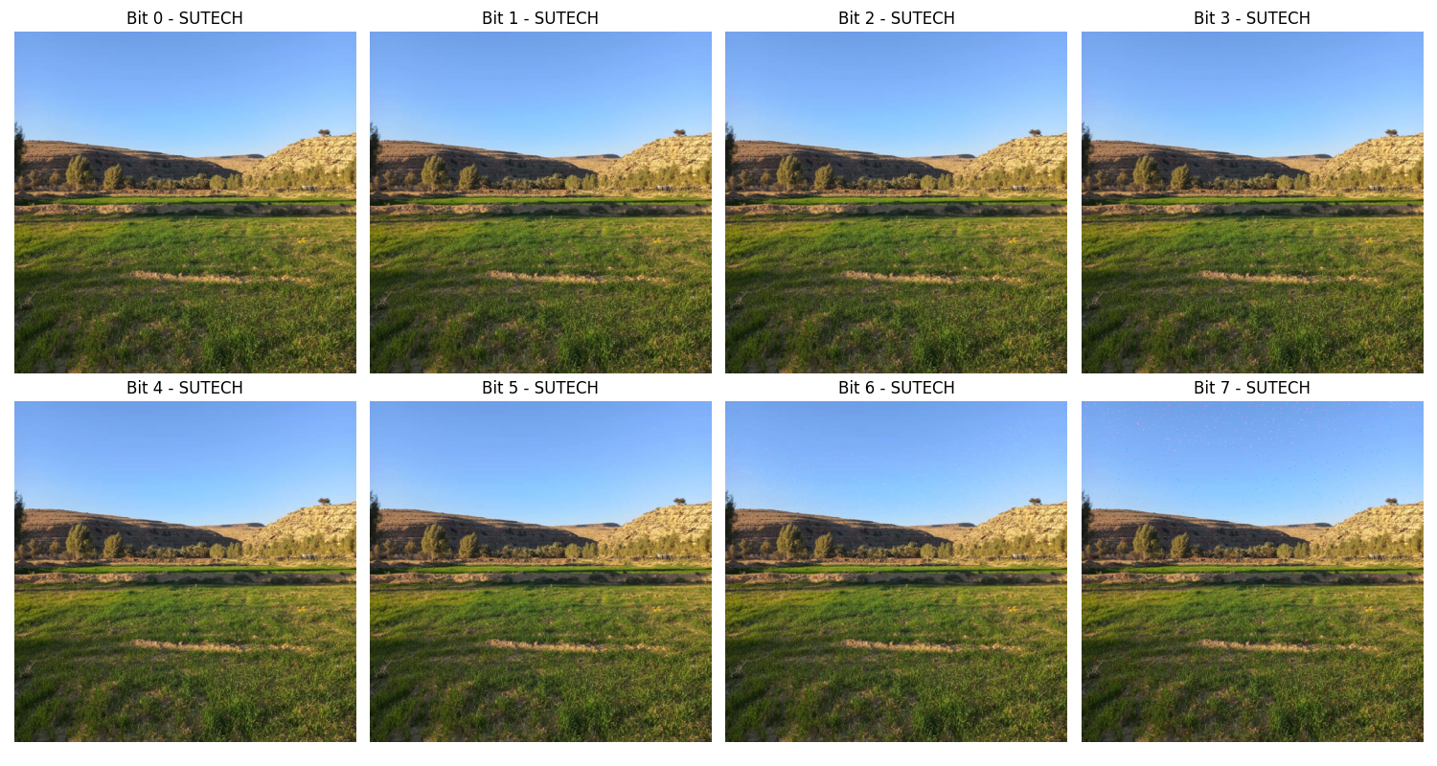
Pseudo Random Location – Red Channel – Sutech Logo

Slide 29
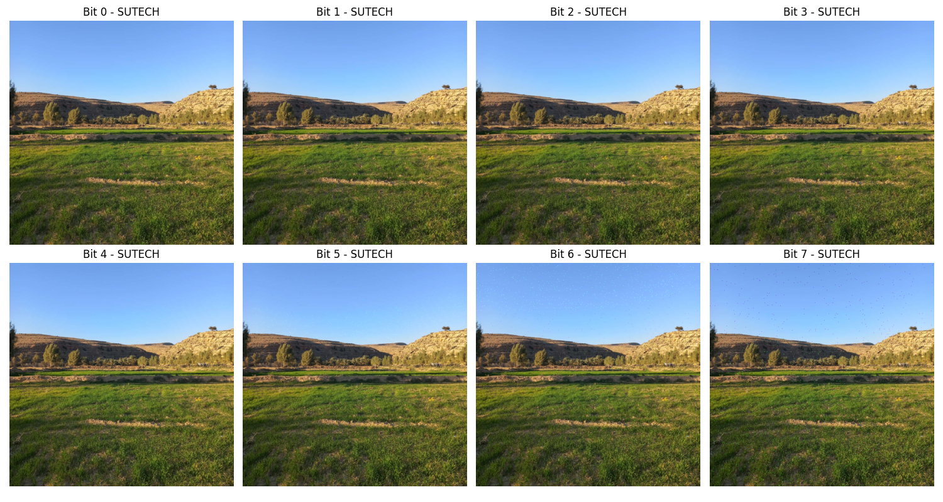
Pseudo Random Location – Green Channel – Sutech Logo

Slide 30
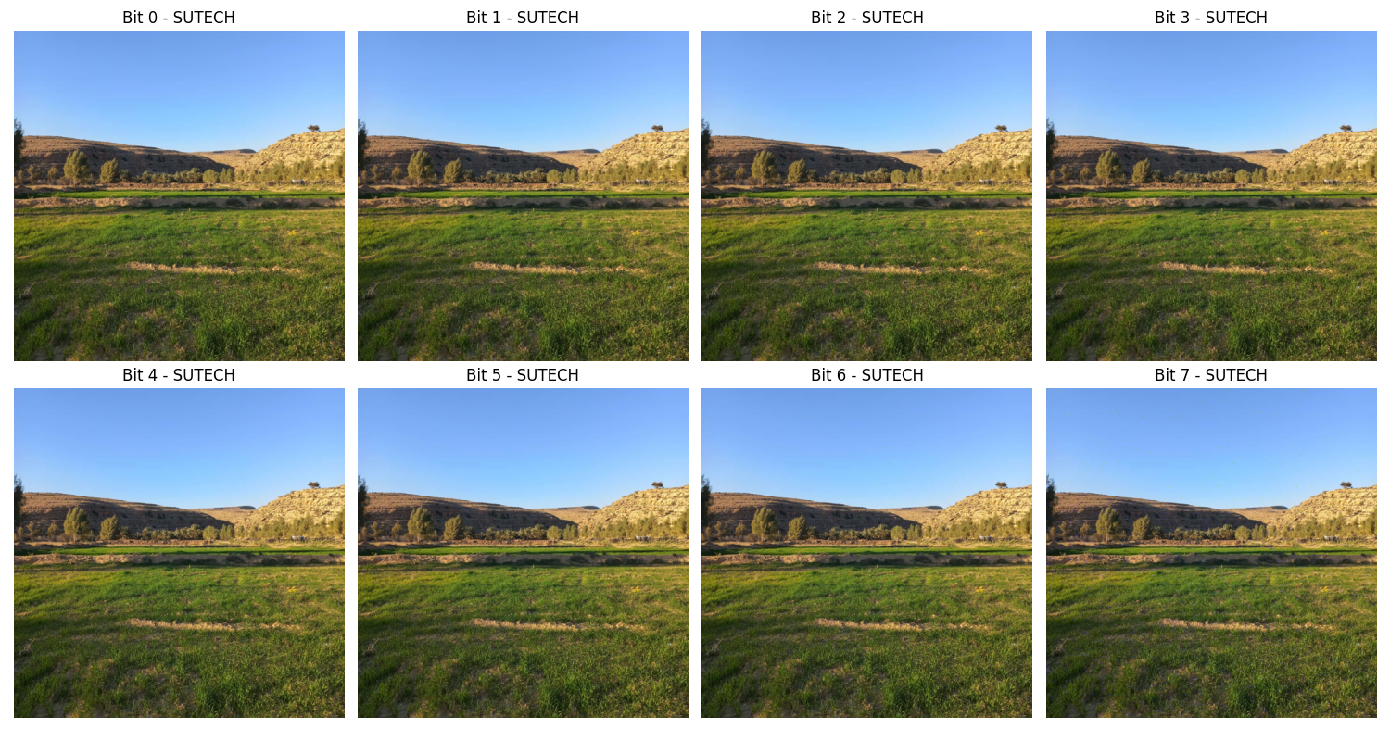
Pseudo Random Location – Blue Channel – Sutech Logo

Slide 31
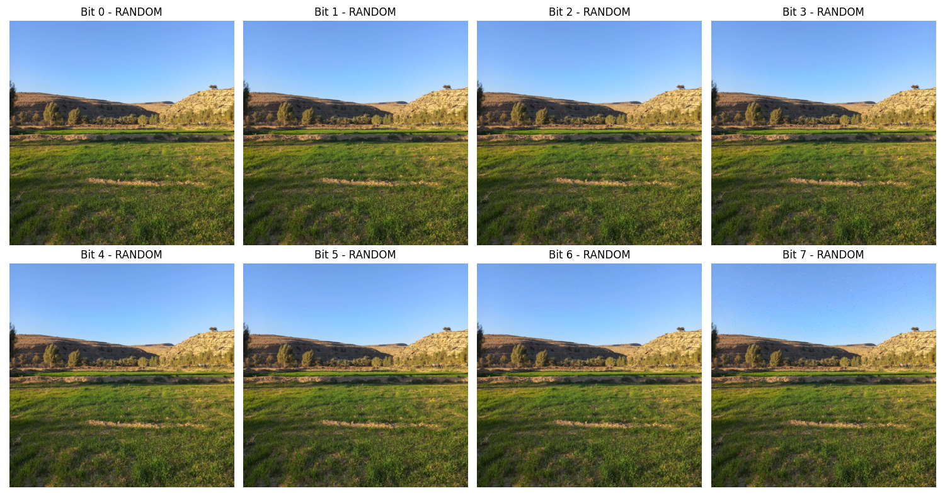
Pseudo Random Location – Red Channel – Pseudo Random Logo

Slide 32
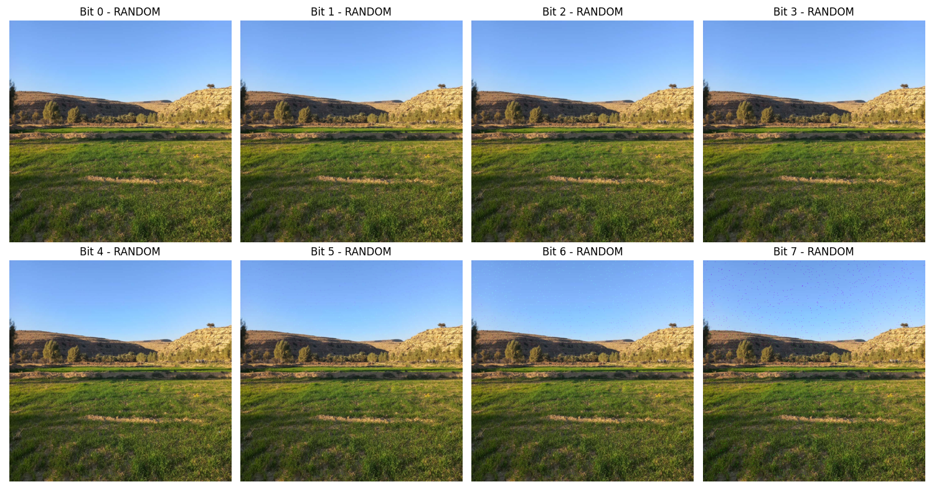
Pseudo Random Location – Green Channel – Pseudo Random Logo

Slide 33
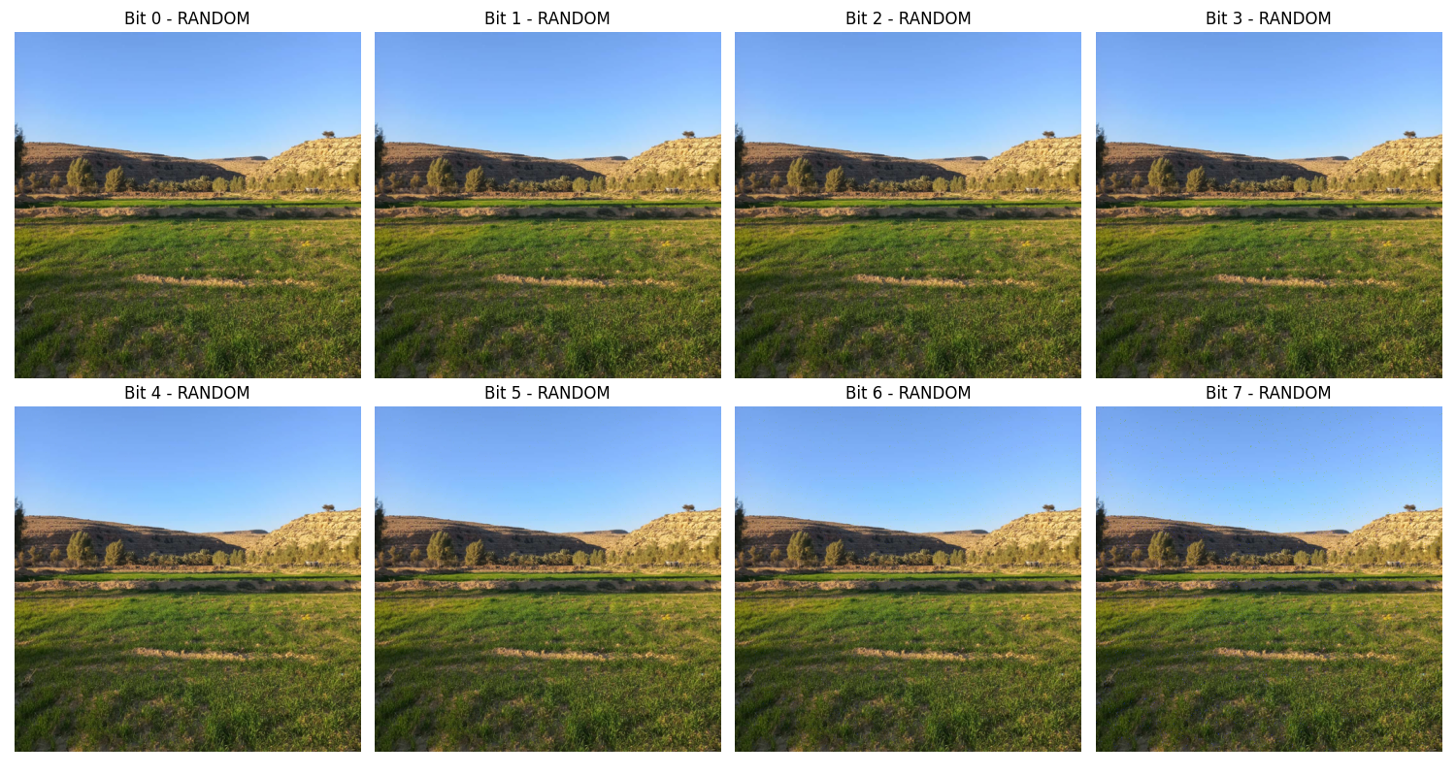
Pseudo Random Location – Blue Channel – Pseudo Random Logo

Slide 34
Implementation Results Extracted Watermark Results
The watermarks remain consistent across all extractions because no modifications such as compression or transmission loss were applied to the watermarked images.
Therefore, I only present a selection of extracted watermark images as representative examples.

Slide 35
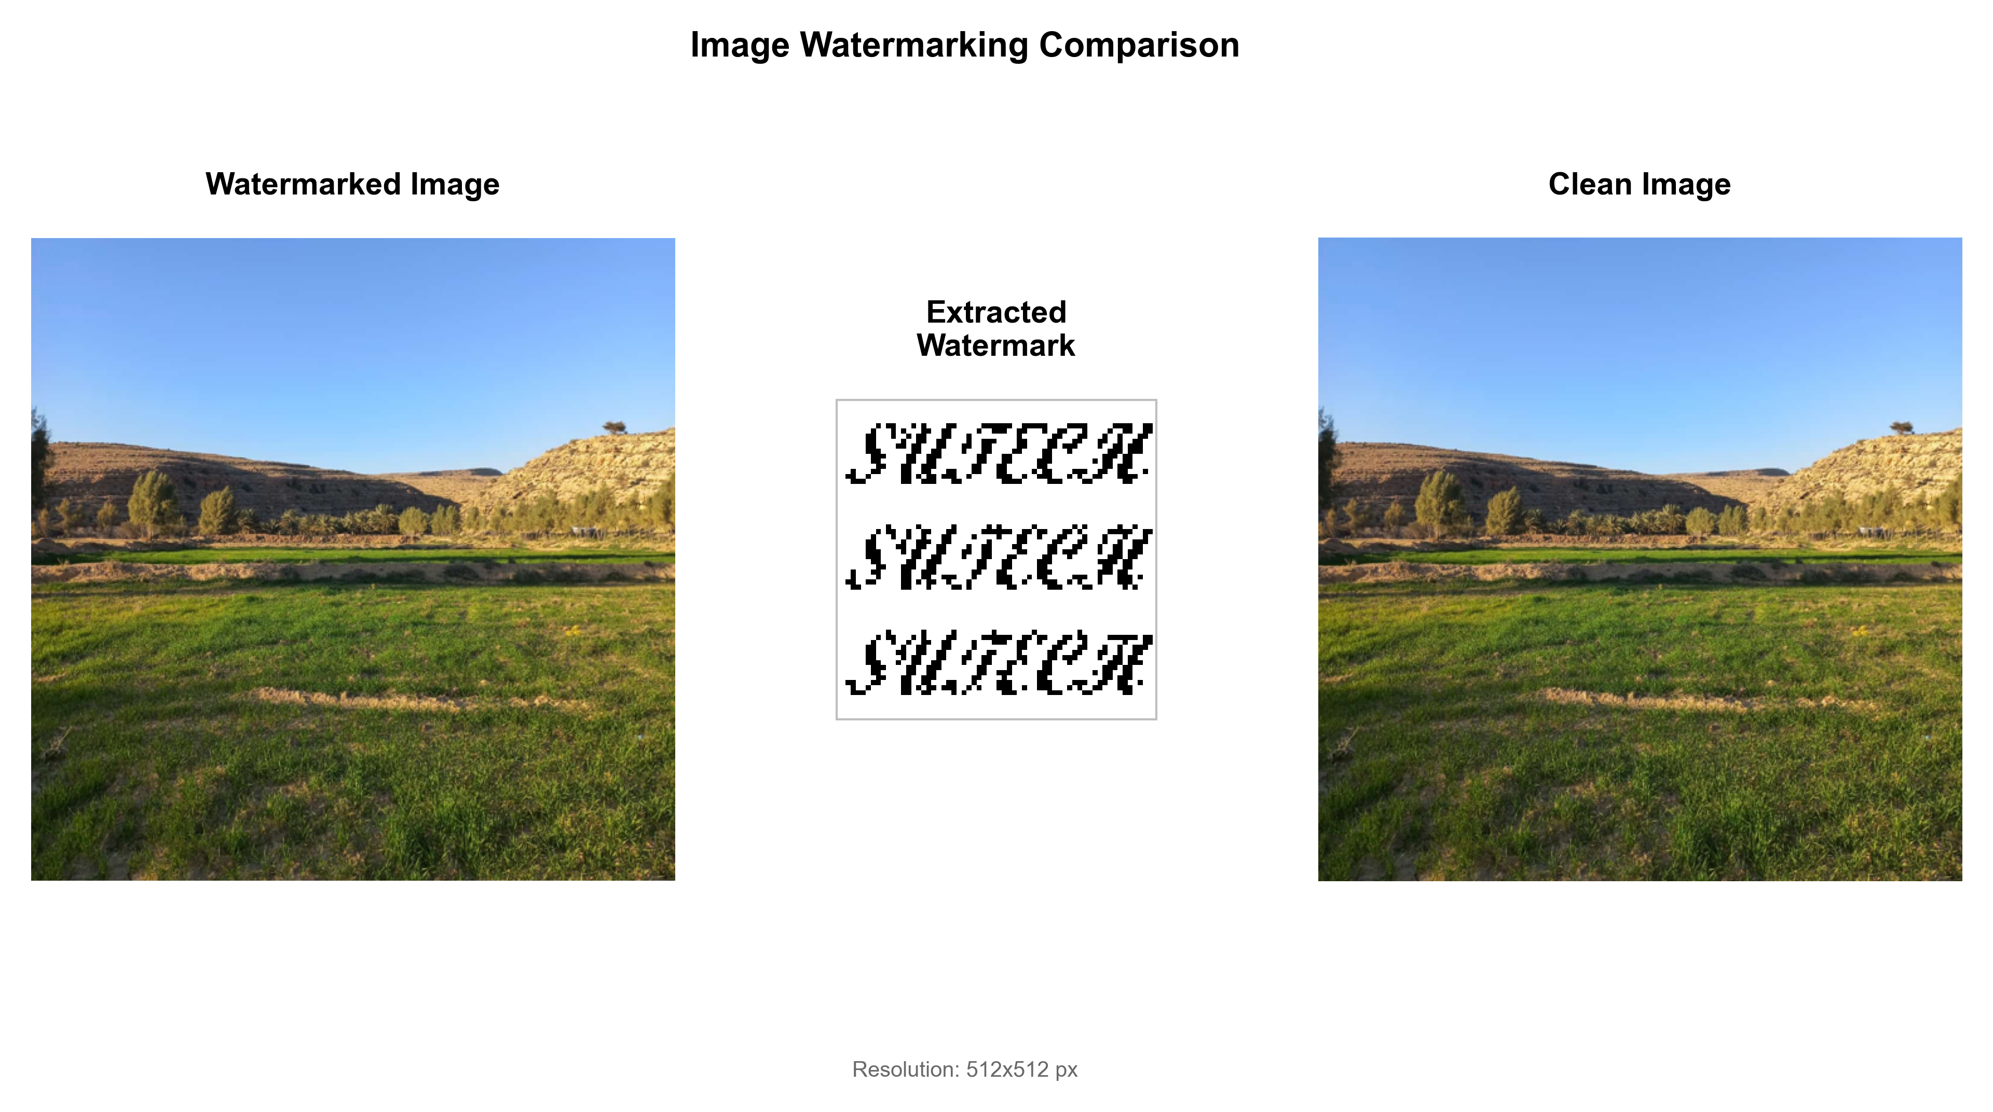
Implementation Results Extracted Watermark Results
Extracted Watermarks – Fixed Location - Examples
Red Channel – Bit 3 – Sutech Logo

Slide 36
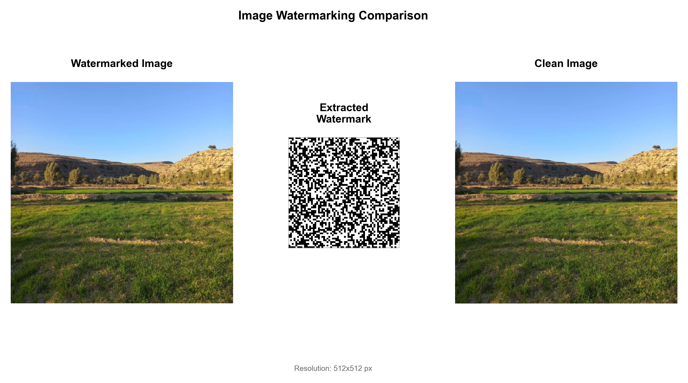
Implementation Results Extracted Watermark Results
Extracted Watermarks – Fixed Location - Examples
Red Channel – Bit 3 – Pseudo Random Logo

Slide 37
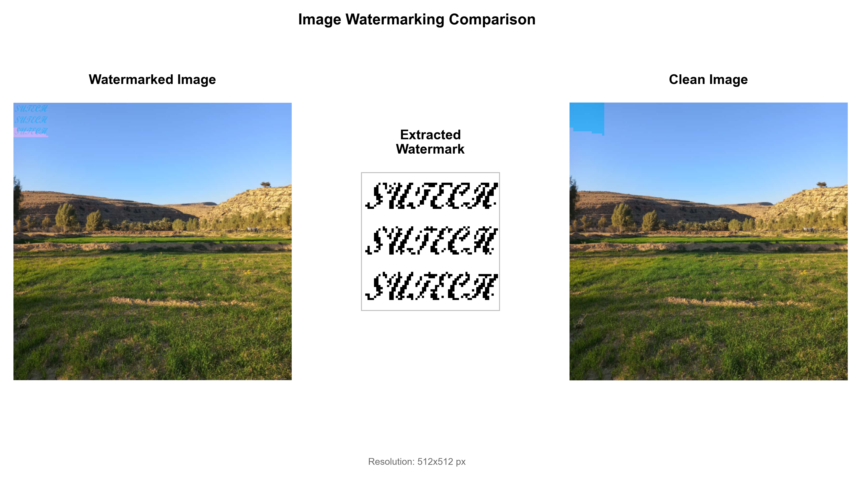
Implementation Results Extracted Watermark Results
Extracted Watermarks – Fixed Location - Examples
Red Channel – Bit 6 – Sutech Logo

Slide 38
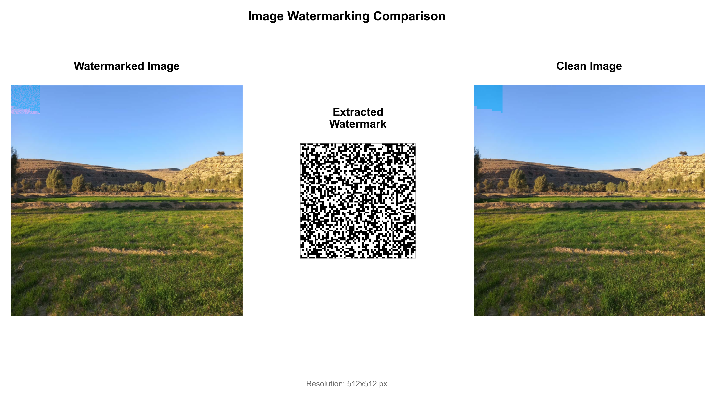
Implementation Results Extracted Watermark Results
Extracted Watermarks – Fixed Location - Examples
Red Channel – Bit 6 – Pseudo Random Logo

Slide 39
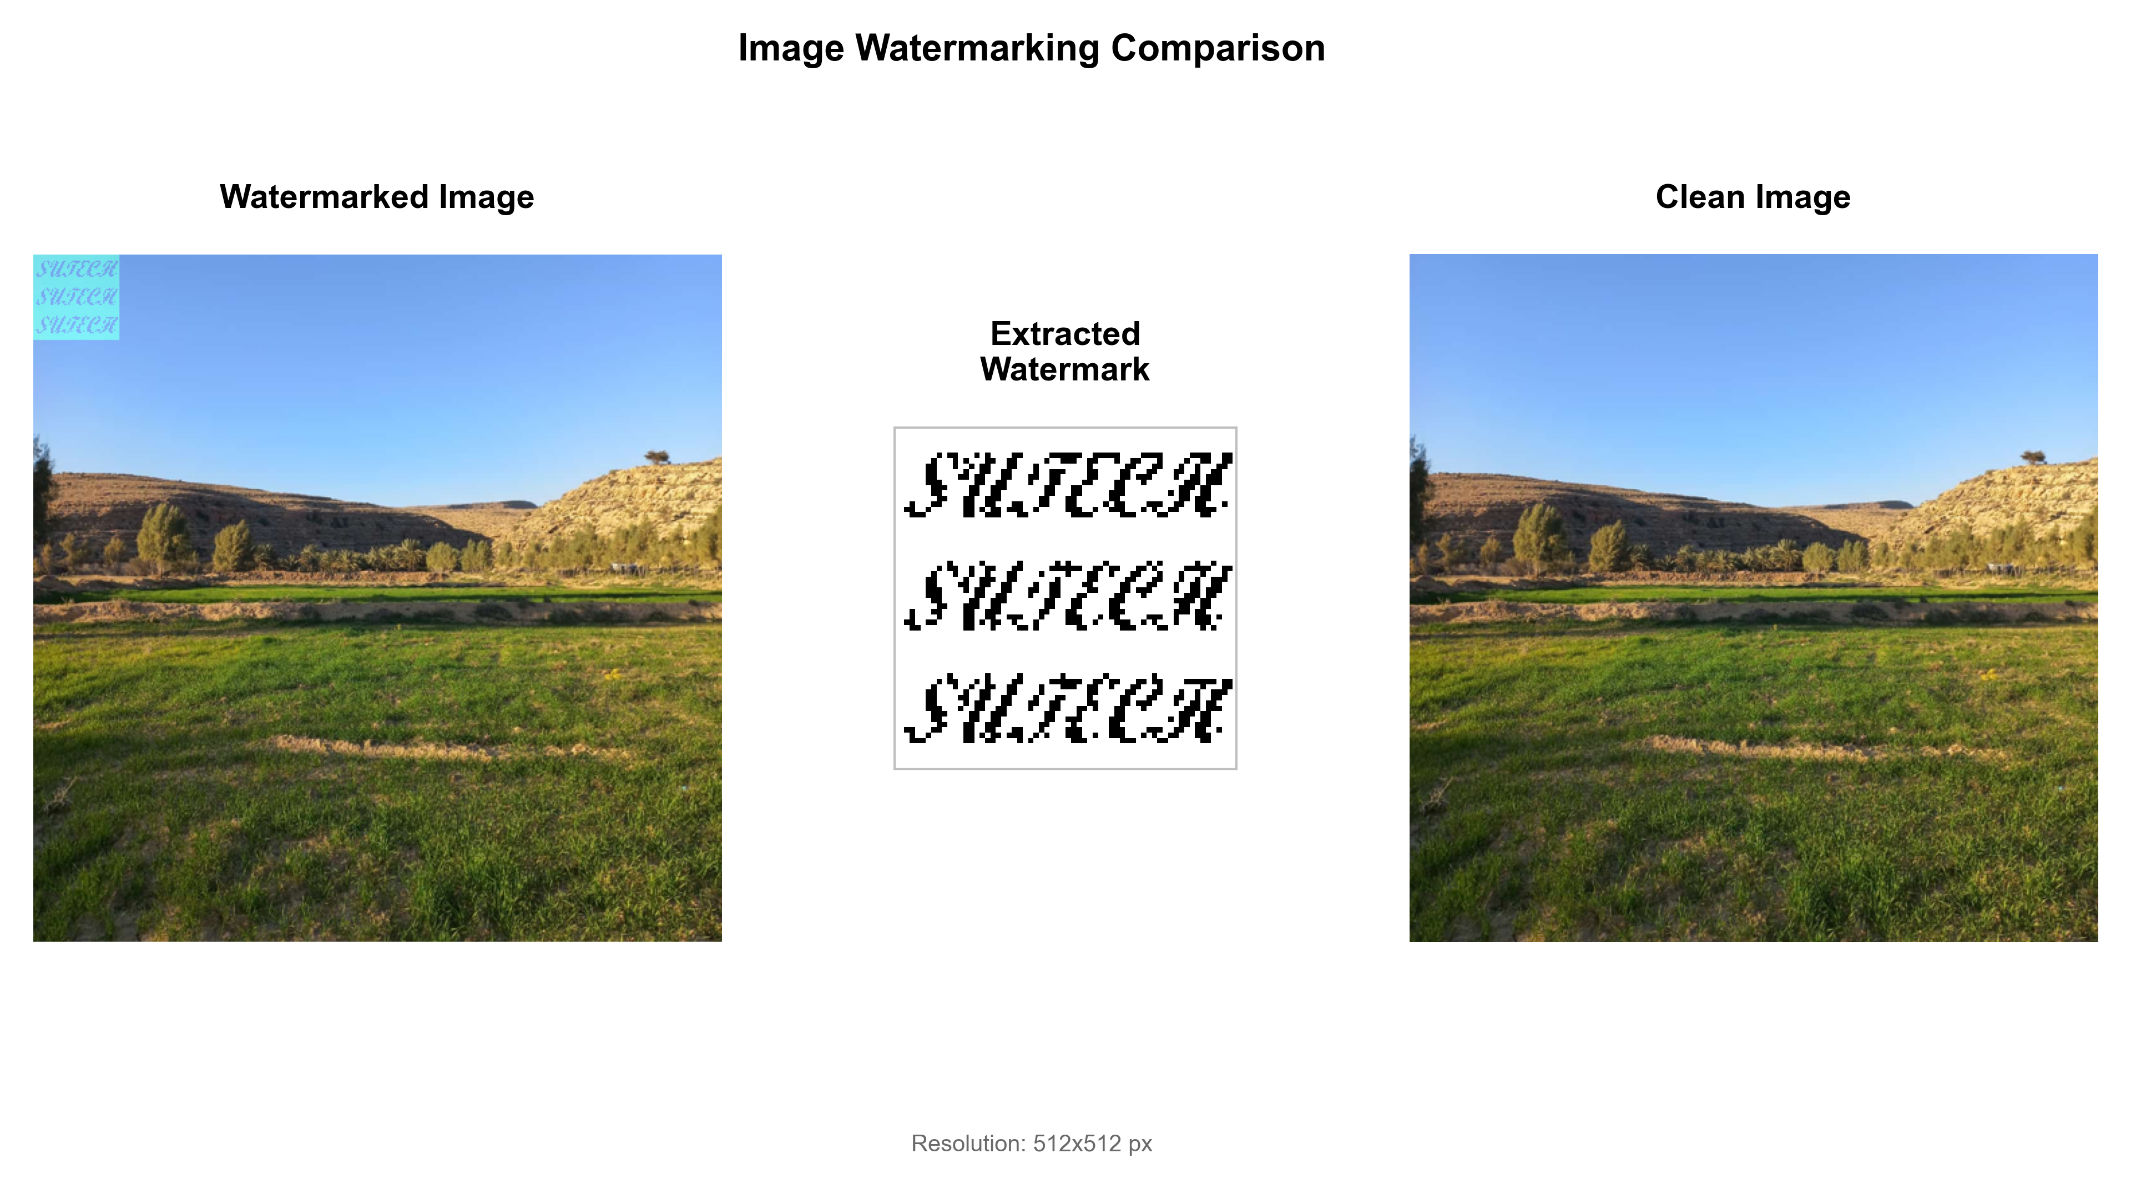
Implementation Results Extracted Watermark Results
Extracted Watermarks – Fixed Location - Examples
Green Channel – Bit 6 – Sutech Logo

Slide 40

Implementation Results Extracted Watermark Results
Extracted Watermarks – Fixed Location - Examples
Blue Channel – Bit 6 – Pseudo Random Logo

Slide 41
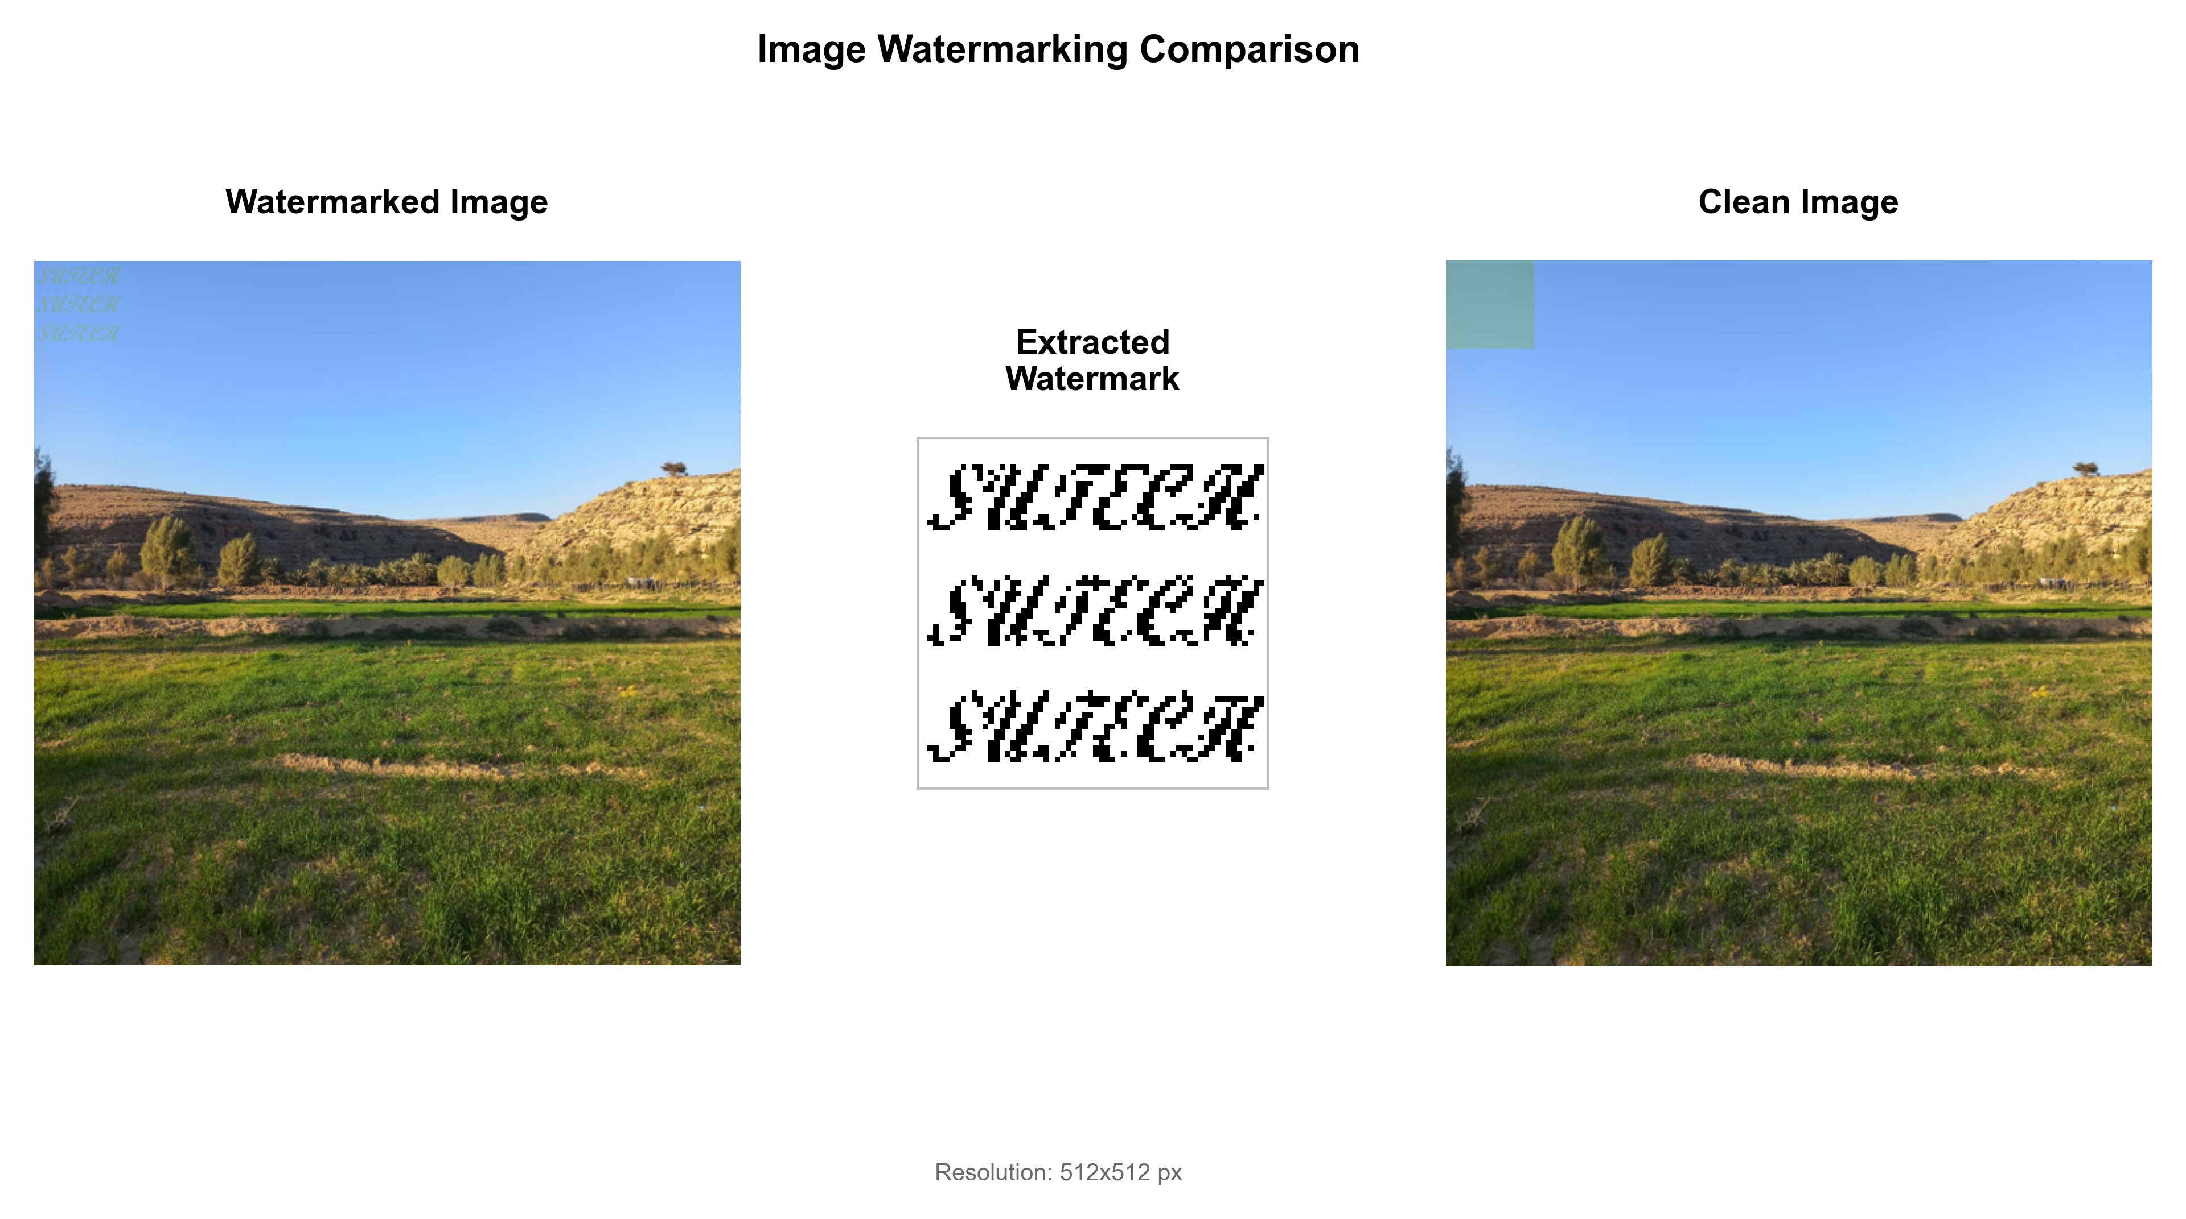
Implementation Results Extracted Watermark Results
Extracted Watermarks – Fixed Location - Examples
Blue Channel – Bit 6 – Sutech Logo

Slide 42

Implementation Results Extracted Watermark Results
Extracted Watermarks – Fixed Location - Examples
Blue Channel – Bit 6 – Pseudo Random Logo

Slide 43

Implementation Results Extracted Watermark Results
Extracted Watermarks – Pseudo Random Location – Examples
Blue Channel – Bit 6 – Sutech Logo

Slide 44

Implementation Results Extracted Watermark Results
Extracted Watermarks – Pseudo Random Location – Examples
Blue Channel – Bit 6 – Pseudo Random Logo

Slide 45
Evaluation Results watermark embedding Results
In the next following slides I will:
Assess the quality impact of watermark embedding across different configurations
Analyze and compare fixed versus random location embedding strategies
Evaluate bit plane selection effects on image quality across R, G, and B channels
Present PSNR and SSIM measurements for both SUTECH logo and pseudo-random pattern watermarks

Slide 46
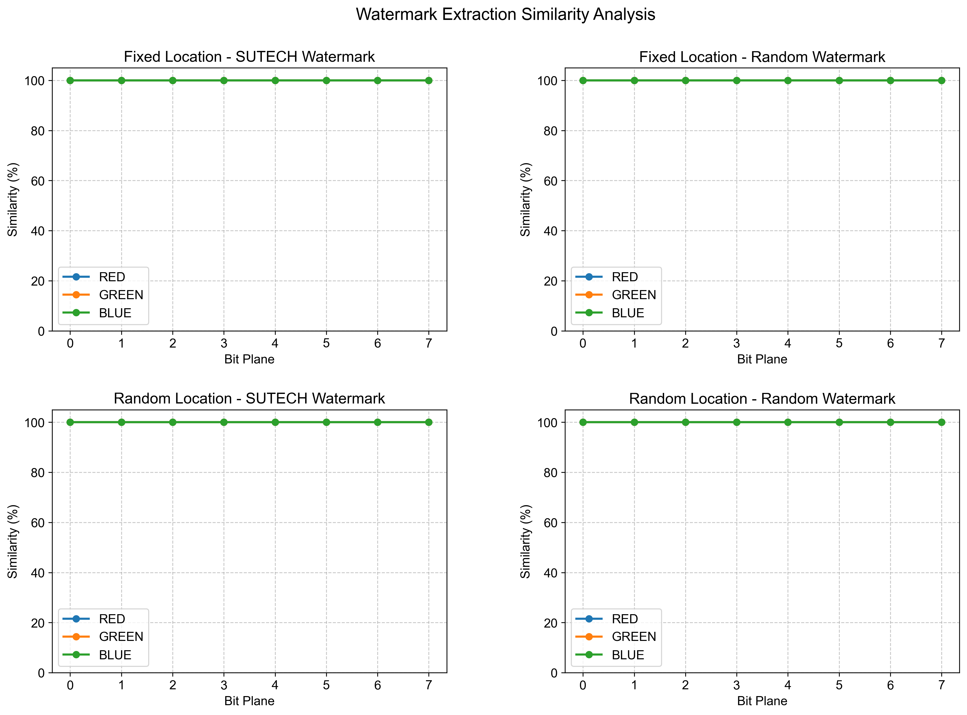
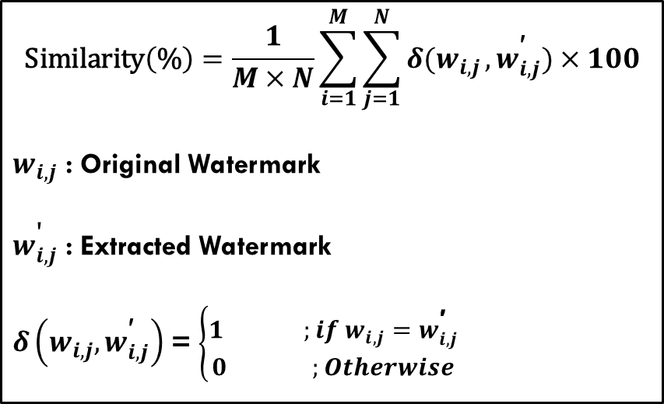
Extracted watermark analysis extracted watermark vs original
I evaluated watermark integrity through direct pixel-by-pixel comparison between the extracted watermark and the original.
$$\text{Similarity}\left(\text{\%}\right)=\frac{1}{M×N}\sum_{i=1}^{M}{\sum_{j=1}^{N}{δ(w_{i,j}},w_{i,j}^{\text{′}})}×100$$
$w_{i,j}$ : Original Watermark
$w_{i,j}^{\text{'}}$ : Extracted Watermark
$δ\left(w_{i,j},w_{i,j}^{\text{′}}\right)$ = $\left\{\begin{aligned}1 ;if w_{i,j}=w_{i,j}^{\text{′}} \\ 0 ;Otherwise\end{aligned}\right.$

Slide 47
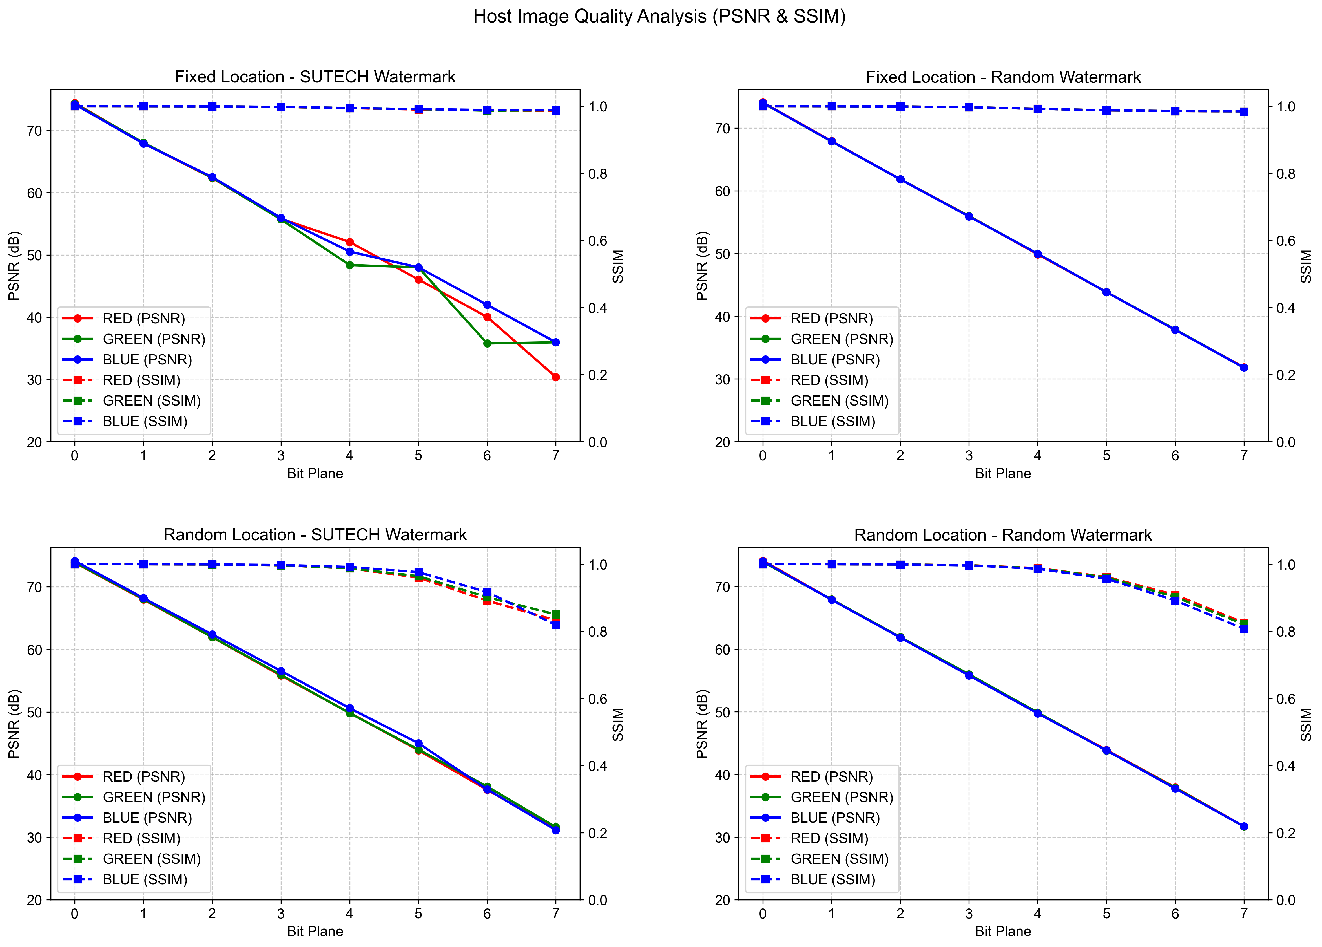
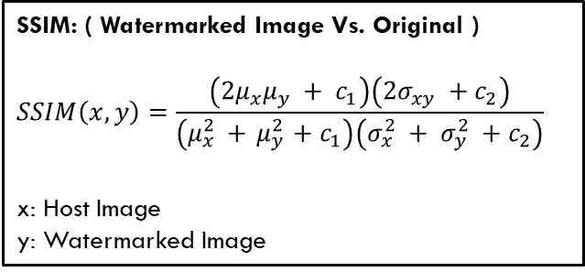
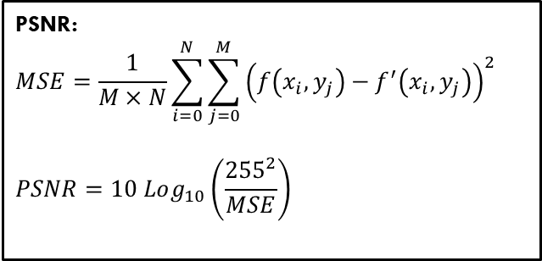
Watermarked image analysis psnr and ssim
PSNR:
$$MSE=\frac{1}{M×N}\sum_{i=0}^{N}{\sum_{j=0}^{M}{{\left(f\left(x_{i},y_{j}\right)−f^{′}\left(x_{i},y_{j}\right)\right)}^{2}}}$$
$$PSNR=10 Log_{10}\left(\frac{{255}^{2}}{MSE}\right)$$
SSIM: ( Watermarked Image Vs. Original )
$$SSIM\left(x,y\right)=\frac{\left(2μ_{x}μ_{y} + c_{1}\right)\left(2σ_{xy} +{ c}_{2}\right)}{\left(μ_{x}^{2} +{ μ}_{y}^{2} +{ c}_{1}\right)\left(σ_{x}^{2} + σ_{y}^{2} +{ c}_{2}\right)}$$
x: Host Image
y: Watermarked Image
Higher values indicate better image quality preservation for both metrics.
PSNR > 40dB and SSIM > 0.95 are generally considered excellent.

